Slide 1

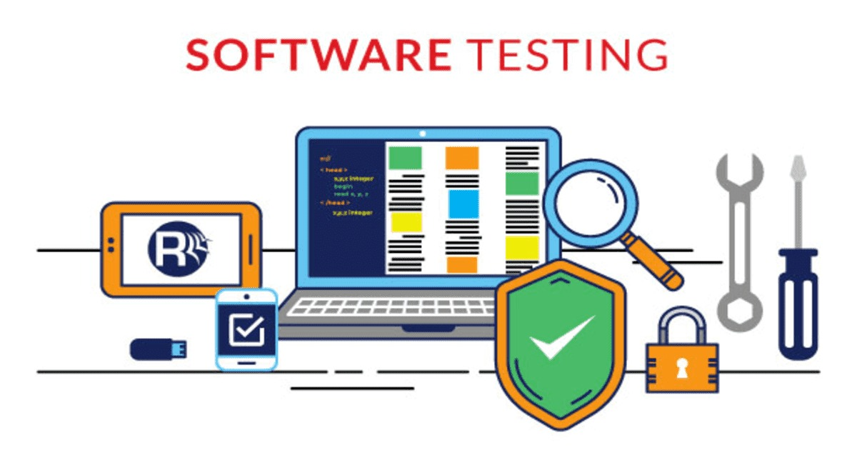
Project Discussion Demo
12-April -2025
MANUAL TESTING
AUTOMATION TESTING
API TESTING

Slide 2
AGENDA
01
Manual Testing
04
Automation Testing
Ahmed
02
API Testing
03
Automation testing
Sarah
Zeinab
Walaa
05
Automation Testing
Youssef

Slide 3

Manual Testing
About the Project :
Project Name: LMS education platform Web Application
Group Name: ALX2_SWD6_G1
Team Name: ALX2_SWD6_G1_Group 5
Job Profile: Software Tester
Project Web site: https://husseinalicoach.talentlms.com/plus/dashboard

Slide 4

Introduction
Purpose of the Test Plan
A structured test plan to ensure the functionality, performance, usability, and security of the LMS web application.
Scope
Validate core features: login, registration, product browsing, and search
Ensure cross-browser compatibility: Chrome, Firefox, Edge
Conduct performance and security testing
Deliverables
Test Plan Document
Manual Test Cases
Test Run Summary
Bug/Defect Log
Performance and Security Testing Results

Slide 5
Test Strategy
Testing Approach
Tools Covered (Jira, Bugzilla, etc.)
Manual vs Automated Testing
Test Environment
Browsers and OS Used
Reporting Tools
Test Data
Types of test data used
Security measures (e.g., encrypted credentials)

Slide 6
Test Schedule
Requirement Analysis
Test Case Design
Test Execution & Reporting
Functional Test Coverage
User Authentication
Product Browsing & Details
Account Management

Slide 7
Test Execution
Use functional requirements to develop test cases
Manual execution
Logging and reporting
Defect Tracking
Tools (Excel, GitHub, Jira)
Test Reporting
Summary Metrics (Executed, Passed, Failed)
Bug Severity Breakdown (High, Medium, Low)

Slide 8
Risk Management
Identified Risks
Risk Assessment
Mitigation Strategies
Risk Monitoring
🌐 LINKS
Test Case design.
Bug Report Excel

Slide 9
API Testing
is the process of verifying and validating the functionality, reliability, security, and performance of application programming interfaces (APIs). It ensures that the API behaves as expected, handles errors appropriately, and integrates seamlessly with other systems or applications. API testing involves sending requests to the API, checking the responses, and ensuring the API functions according to specified requirements and handles edge cases effectively.
Project Name: Simple Book API
Project Link:ALX2_SWD6_G1_Group5/postman pic.pdf at main · SarahElHassan1/ALX2_SWD6_G1_Group5

Slide 10
Automation Testing
Scenario 1 : E2E from Login to checkout
https://view.officeapps.live.com/op/view.aspx?src=https%3A%2F%2Fraw.githubusercontent.com%2FSarahElHassan1%2FALX2_SWD6_G1_Group5%2Frefs%2Fheads%2Fmain%2FTest%2520scenario%2520walaa.docx&wdOrigin=BROWSELINK
Scenario 2: E2E place order
Automation Scenario Sa.docx
Scenario 3: E2E Cancel order
Test scenario Yousef.docx

Slide 11
QUESTIONS

Slide 12



Thank You!

